Slide 1


Dark Matter Subhalo Interpretations Using Machine Learning:
_{The Fourth Fermi-LAT Catalog}
There exists more matter in the Universe than is observable
~ Zwicky, 1933
Einstein Toolkit Conference 2024
Amrutaa Vibho
Norwich University

Slide 2

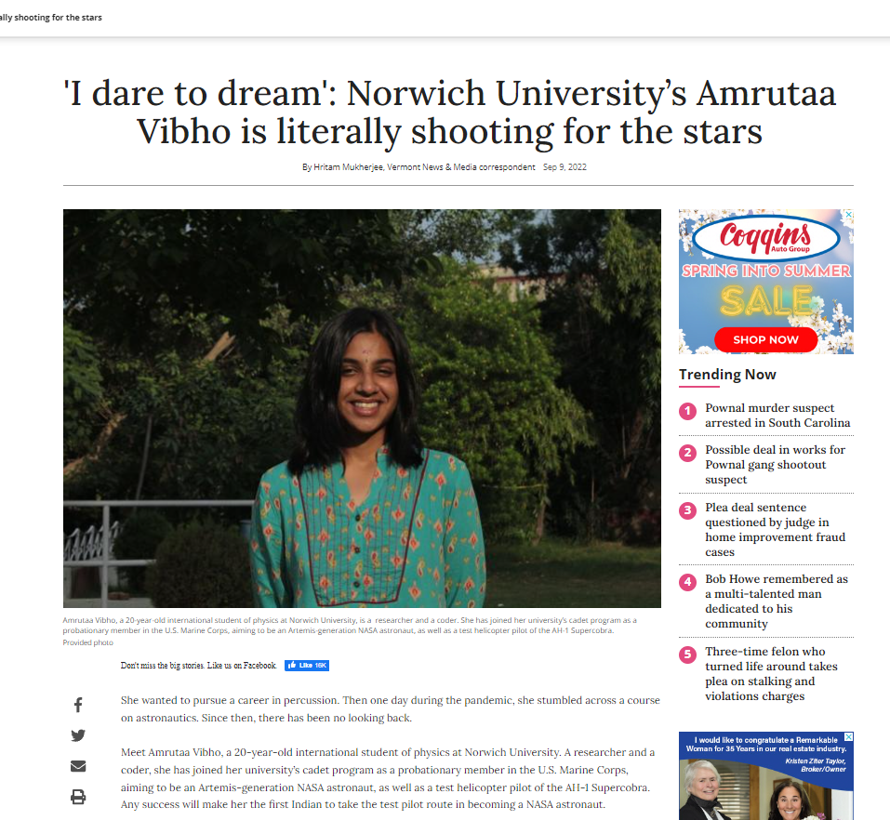
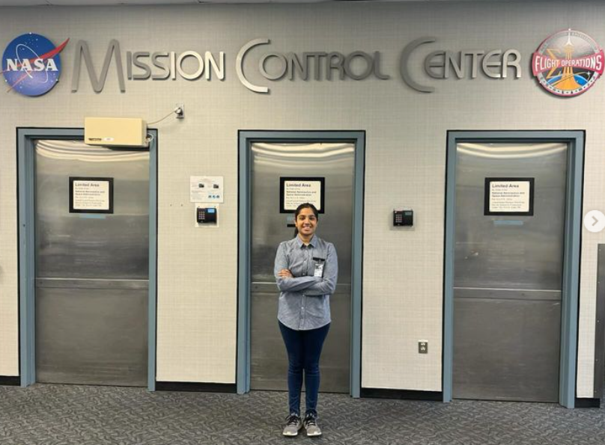
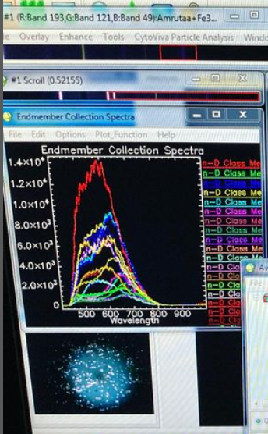
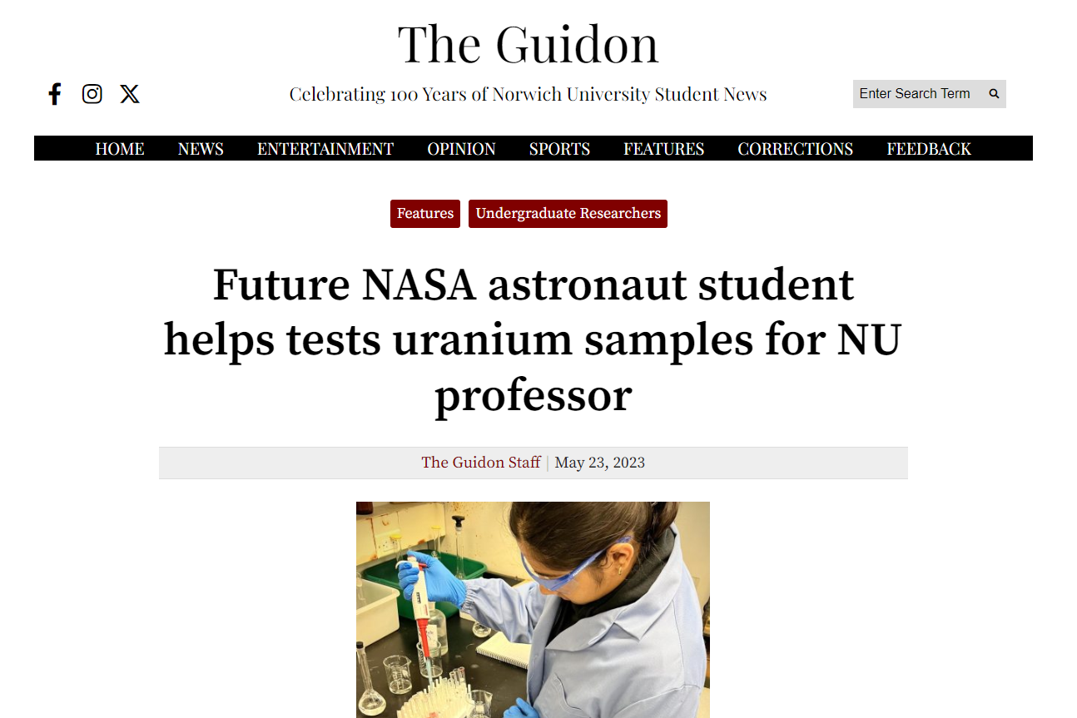

Slide 3

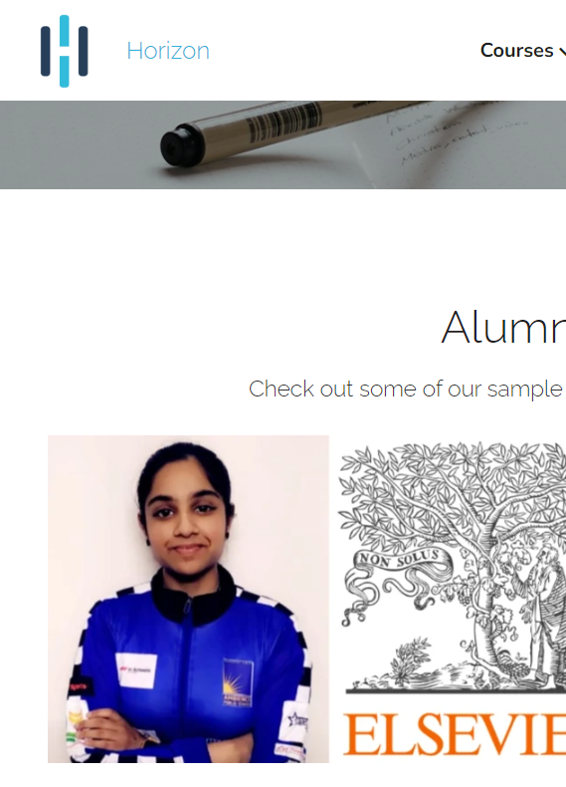
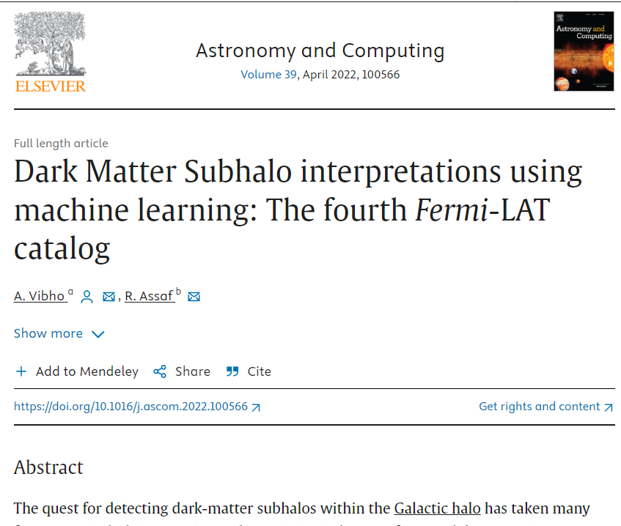

Slide 4
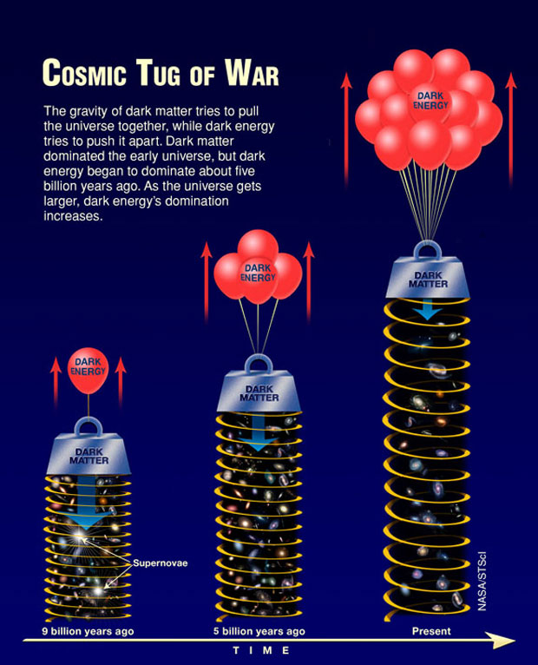
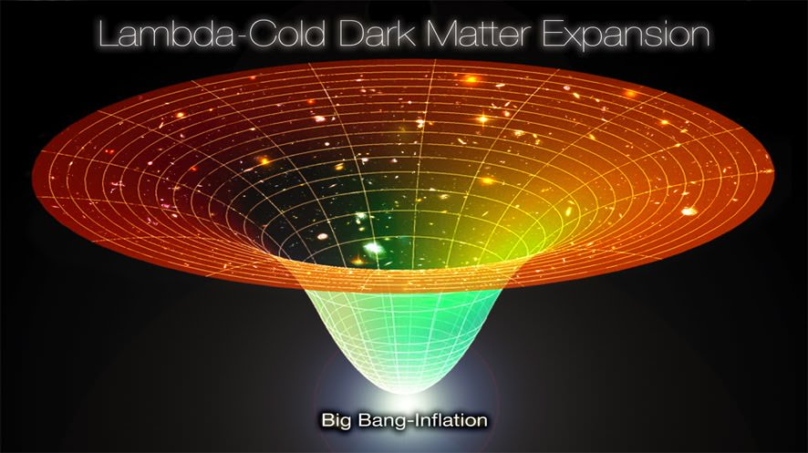
Why Dark Matter
Aim: To describe all matter interaction under one physical framework – Reconcile Electromagnetism and Gravity
DM/DE could explain greater/less-than-expected Gravitational Forces. Explanation of matter interaction under the effects of Gravity

Slide 5
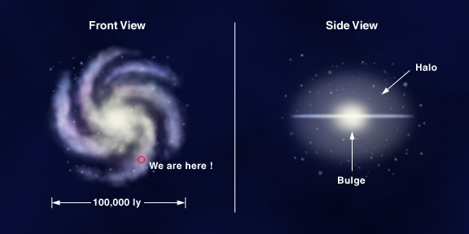
Motivation
Challenge
Rotation curves of spiral galaxies, large-scale structures, and hierarchical assembly processes confirm DM hypothesis; cold DM n-body simulations predict DM population in Galactic Halo
Near-null star formation; Optical Surveys can’t detect Dark Matter Subhalo candidates!

Slide 6
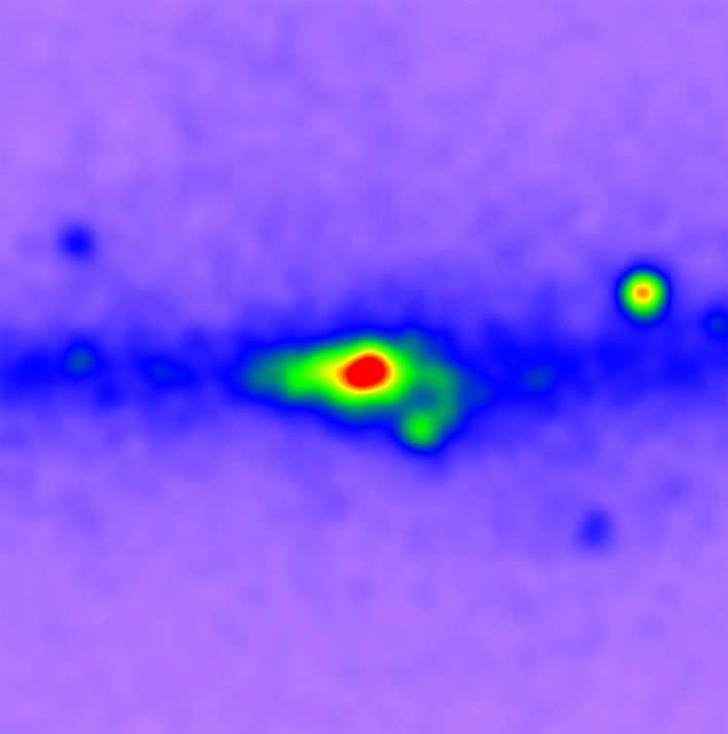
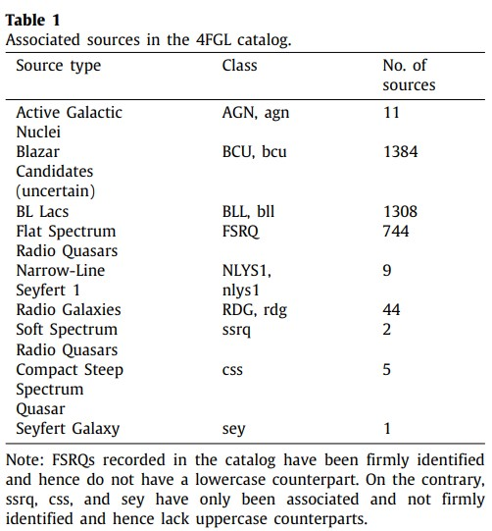
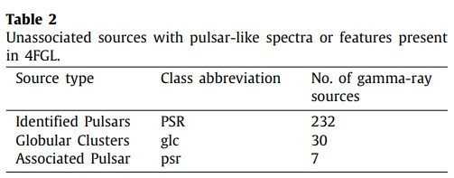
Hypothesis
Spectral Qualification
Fermi-LAT has recognized that WIMPs in the nearest subhalos could produce annihilation spectra nearly indistinguishable from that of gamma-ray pulsars.
WIMP Annihilation ~= High-latitude, non-variable gamma-ray pulsar candidates without detected gamma-ray events
Subhalo set fall within the 20–70 GeV range, consistent with DM Annihilation Range

Slide 7
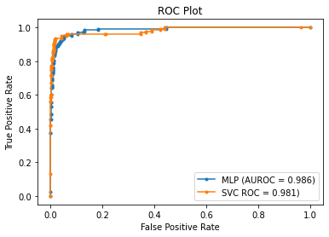
Why Machine Learning
Learning complex relationships between astrophysical systems
Cut across Imbalanced Data (available/detectable) to override Bias and predict accurate relationship
SVC (Bayesian Validation) and ANN (layer-learning) reveal intricate patterns that are otherwise hidden; crucial for Primordial astrophysical systems where not much is accessible – prediction is basis for investigation

Slide 8
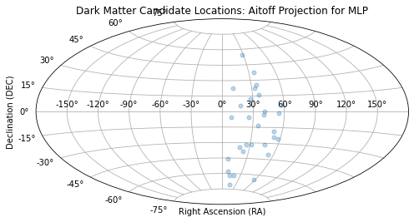
Eureka!
Outcome Right Ascensions and Declinations for the 30 DM Candidates project their location in the gamma-sky
-> 5788 Sources
-> 1667 Unassociated
-> 835 above 10 degrees of Galactic Plane
-> 30
potential Dark Matter Candidates in the Milky Way Subhalo

Slide 9
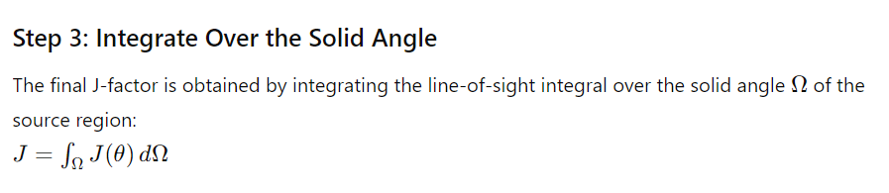
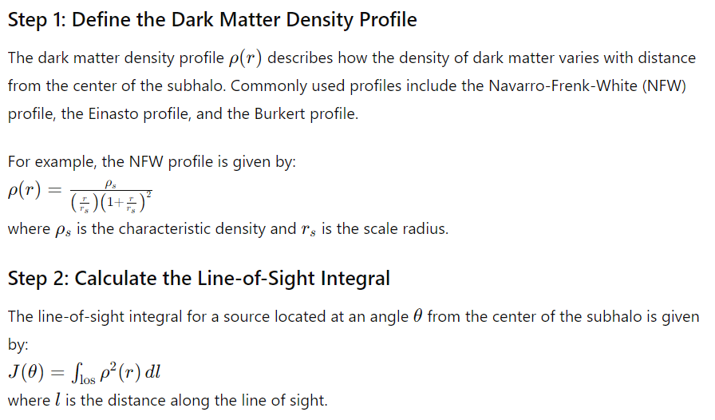
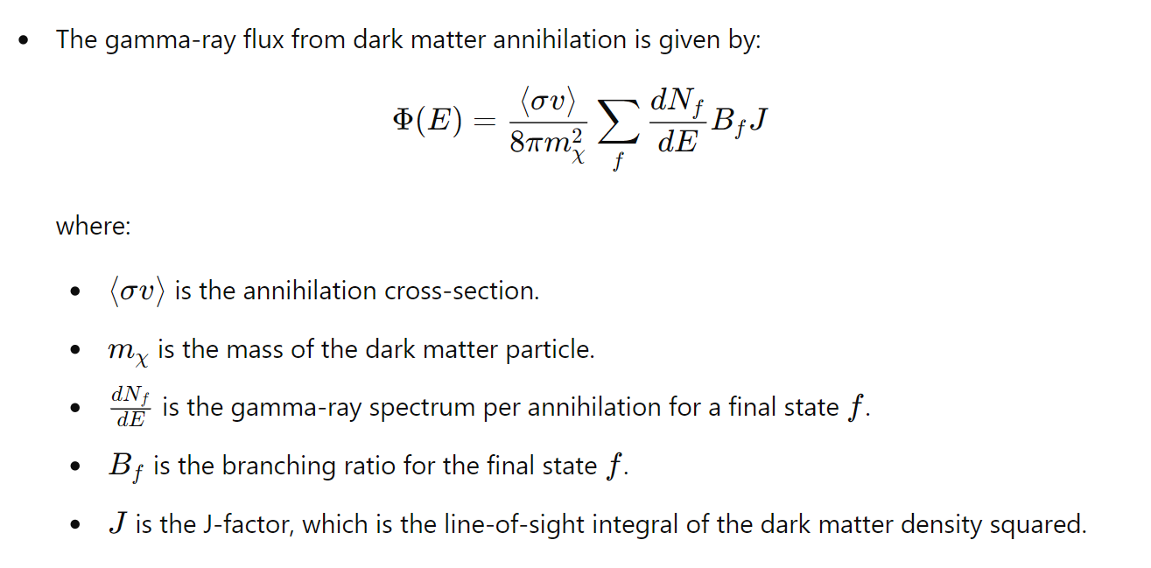
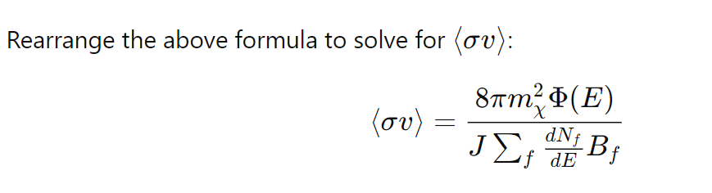

Slide 10
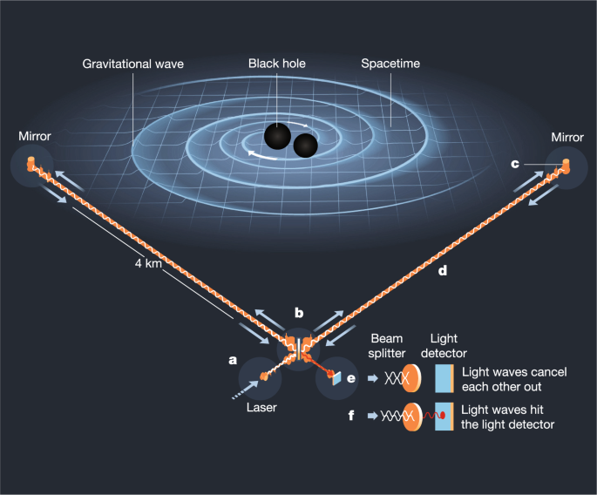
Present work:
Using the Gravitational Wave Transient Catalog (GWTC) by LIGO-VIRGO-GWOSC, ascertain by comparing ML models and simulations whether Dark Matter could entirely comprise of PBHs

Slide 11

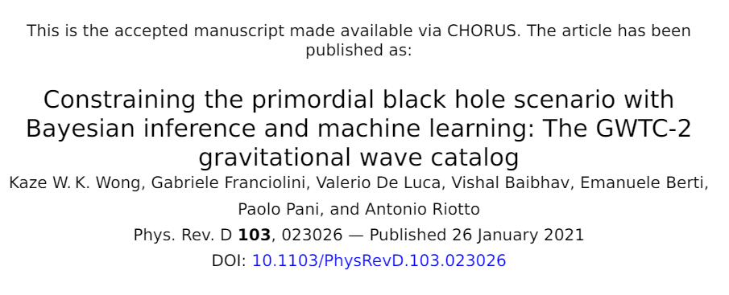


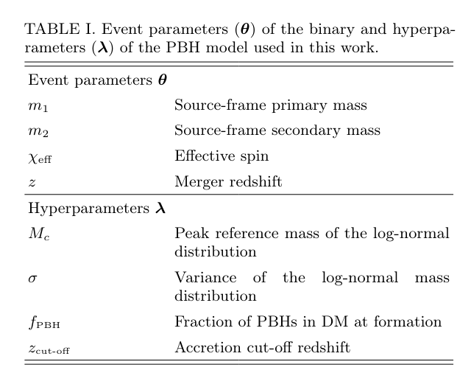

Challenges:
Association with known sources between increment releases
Investigate if possibly not self-annihilating
PBH?
Use NR signal models for synthetic PBHs and train on GWTC data after parameter estimation
Success in this could give new gravitational wave-gamma ray research for Fermi-LAT data.

Slide 12
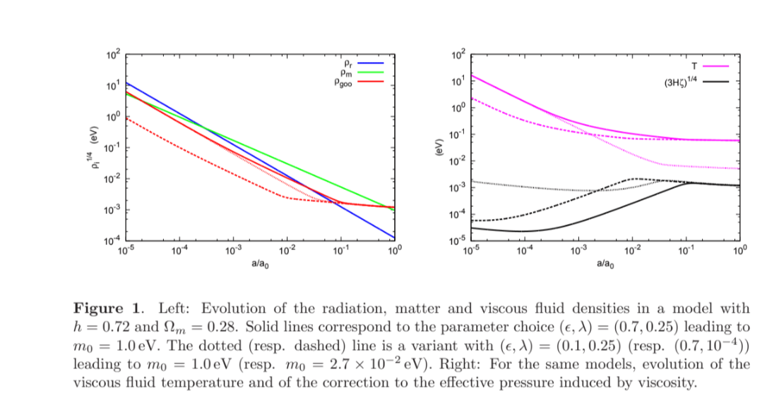
The paper "Dark Goo: Bulk Viscosity as an Alternative to Dark Energy"
Proposes that bulk viscosity in the universe could explain its current acceleration. The authors present a model incorporating self-interacting spin-zero particles that add bulk viscosity to the usual energy content. This viscosity modifies the pressure, creating an "effective" negative pressure that mimics dark energy. The model achieves dark energy behavior without fine-tuning and maintains well-behaved linear perturbations. The particles must be in local equilibrium today for these viscous effects to be significant.
Shear viscosity is (artificially) set to zero in the Dark Goo model, but it may have some interesting consequences. In particular, it may affect perturbations in the early universe, while leaving the dark energy-like behavior due to bulk viscosity in the late universe intact. This may help in explaining the so-called “Hubble tension” between early and late measurements of the Hubble parameter
Jean-Sebastien Gagnon and Julien Lesgourgues JCAP09(2011)026

Slide 13
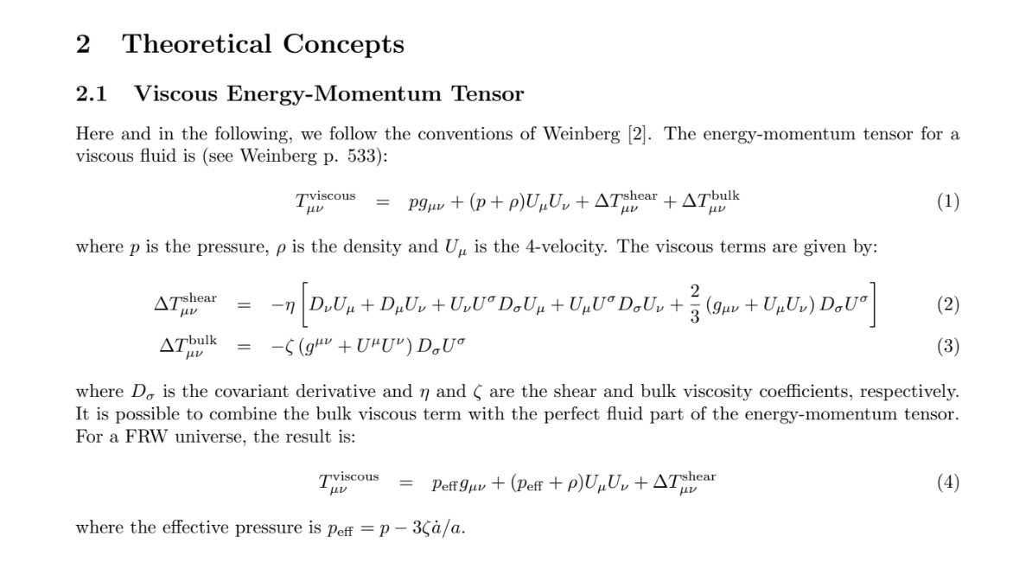
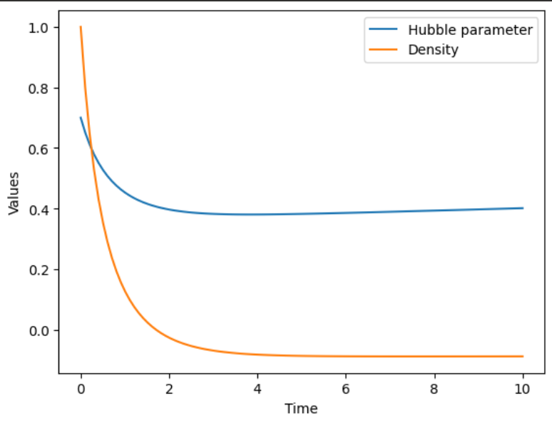


Slide 14
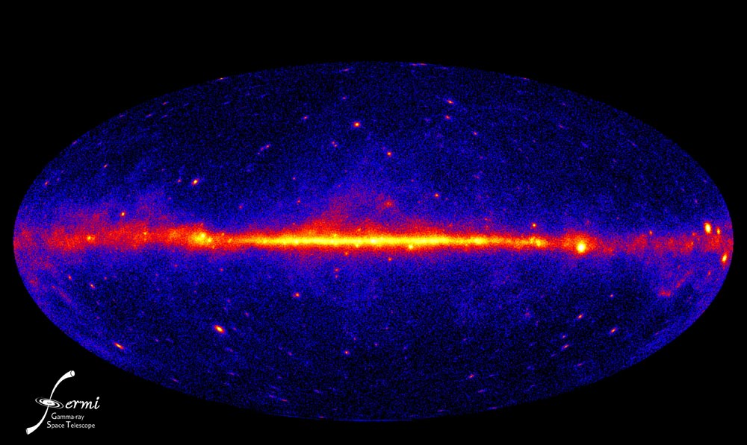
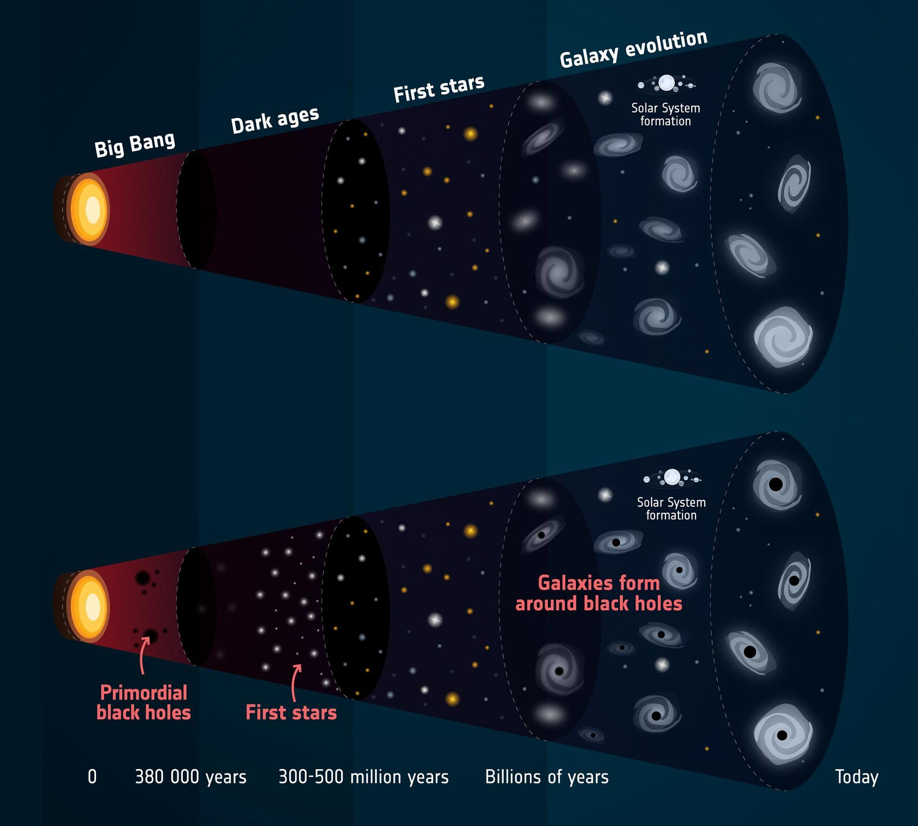
Ad Astra
Thank you!

